Slide 1
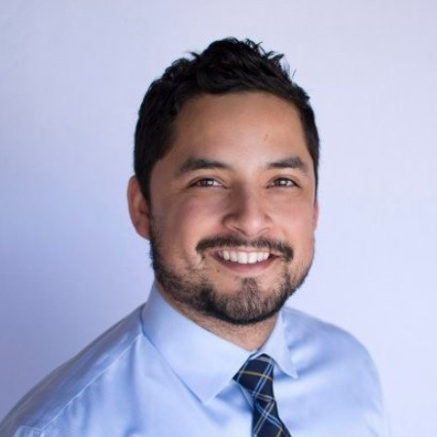
David Quinonez Consultant - Acceleration
Email
David.Quinonez@thebridge.com
Location
DFW, Texas
Mobile
(817) 368-1709
EXPERIENCE
David joined The Bridge in October 2023. He brings 10 years of experience in business operations, data analytics, and program management.
Industry Experience
Excel | SalesForce | SmartSheets | SQL | PowerBI
Business Analyst/Data Operations Manager
Analyzed key aspects of business to evaluate factors driving results, summarized key data points into Client Presentations to discuss and advise successful next steps with the client.
Procure Quarterly, Monthly, and Daily reports on company financial metrics through Excel Dashboards to Executives and advise successes as well as strategize areas of improvement.
Manage three team members with daily duties to capture progress and achieve assigned Key Performance Indicators and support their career growth.
Initiated new processes through platforms such as Salesforce, Smartsheets, etc. and integrating into systems for more efficient visibility to team KPI performance and Business Analytics.
Business Development Manager
Developed business pipeline from the ground up with cost effective solutions to meet client's business objectives within budget totaling over $100k in first year and $500k the second year and awarded 8 national brand businesses through successful RFP development
Managed a diverse portfolio supporting the client through full project life cycle (initial inquiry to test report delivery), specializing in all business lines (Hardlines, Softlines, etc.)
Support client with knowledge of regulations and test standards, intelligently utilize internal technical resources to provide best support to win and retain business and collaborate with customer service/project management to serve client.
Knowledgeable to review products (Food Contact, Medical Devices, and Cosmetics) and navigate through the FDA 21 CFR as well as other regulatory agencies (German BfR and EU 10/2011) and diagnose the proper testing to meet compliance within each agency.
BACKGROUND
Education
BS Biology - University of Texas at Arlington
Functional Skills
Analysis, Business Development, CRM, Data Analysis, Data Collection, Portfolio Management, SQL

Slide 2

Email
David.Quinonez@thebridge.com
Location
DFW, Texas
Mobile
(817) 368-1709
David joined The Bridge in October 2023. He brings 10 years of experience in business operations, data analytics, and Client Relationship/Program Management.
David Quinonez
Consultant
Acceleration

Slide 3
David Quinonez Consultant — Acceleration
Email
David.Quinonez@thebridge.com
Mobile
(817) 368-1709
Location
DFW, Texas
BACKGROUND
EXPERIENCE
Education
BS Biology – University of Texas at Arlington
Functional Skills
Analysis, Business Development, CRM, Data Analysis, Data Collection, Portfolio Management, SQL
Industry Experience
Excel | SalesForce | SmartSheets | SQL | PowerBI
Business Analyst/Data Operations Manager
Analyzed key aspects of business to evaluate factors driving results, summarized key data points into Client Presentations to discuss and advise successful next steps with the client.
Procure Quarterly, Monthly, and Daily reports on company financial metrics through Excel Dashboards to Executives and advise successes as well as strategize areas of improvement.
Manage three team members with daily duties to capture progress and achieve assigned Key Performance Indicators and support their career growth.
Initiated new processes through platforms such as Salesforce, Smartsheets, etc. and integrating into systems for more efficient visibility to team KPI performance and Business Analytics.
Business Development Manager
Developed business pipeline from the ground up with cost effective solutions to meet client's business objectives within budget totaling over $100k in first year and $500k the second year and awarded 8 national brand businesses through successful RFP development
Managed a diverse portfolio supporting the client through full project life cycle (initial inquiry to test report delivery), specializing in all business lines (Hardlines, Softlines, etc.)
Support client with knowledge of regulations and test standards, intelligently utilize internal technical resources to provide best support to win and retain business and collaborate with customer service/project management to serve client.
Knowledgeable to review products (Food Contact, Medical Devices, and Cosmetics) and navigate through the FDA 21 CFR as well as other regulatory agencies (German BfR and EU 10/2011) and diagnose the proper testing to meet compliance within each agency.

